Slide 1
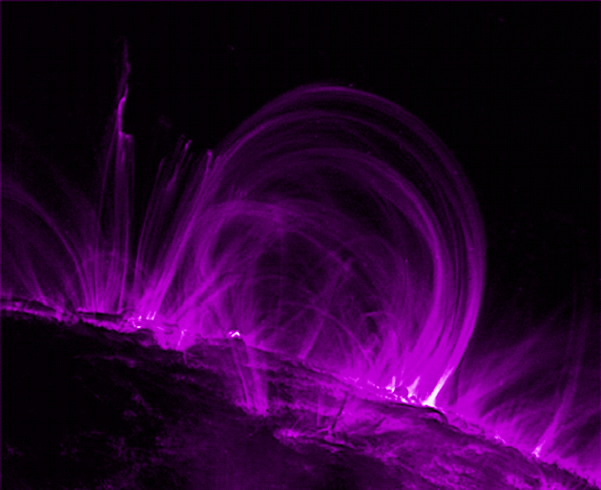
Magnetism and Coils (Solenoids)

Slide 2
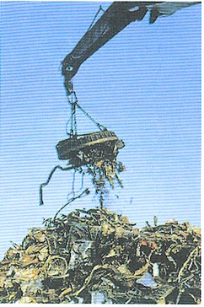
Electromagnets
Electromagnet – an object that exerts a magnetic force using electricity
A crane in a junk yard, can turn its magnetic field off and on to lift a pile of scrap metal and release it using electricity

Slide 3
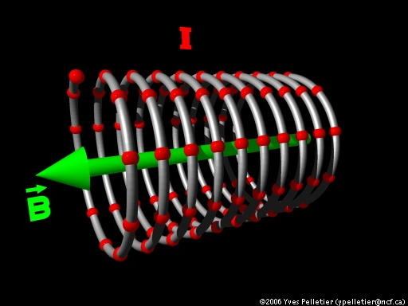
Solenoid
A solenoid represents a coiled loop of wire
Current flows through the coiled loop and creates a magnetic field around the solenoid.
A solenoid is a type
of electromagnet

Slide 4
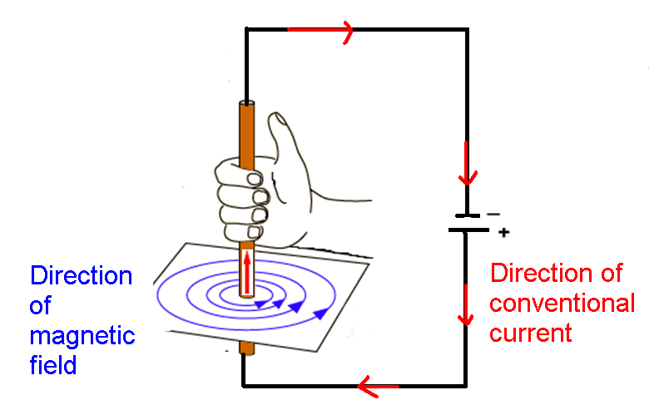
Review: Right Hand Rule #1
Oersted’s principle: A moving electric current creates a magnetic field!

Slide 5
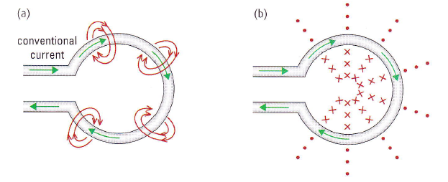
Extension – Loop of Wire

Slide 6
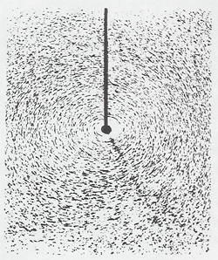
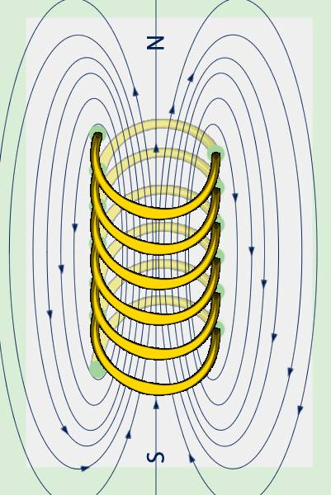
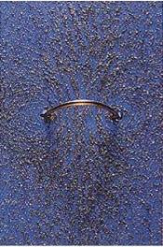
Magnetic Field around a Solenoid
Looping the wire turns the magnetic field into a toroidal (donut) shape.
Many loops in a solenoid shape creates a dipole-shaped magnetic field, similar to that of a bar magnet

Slide 7
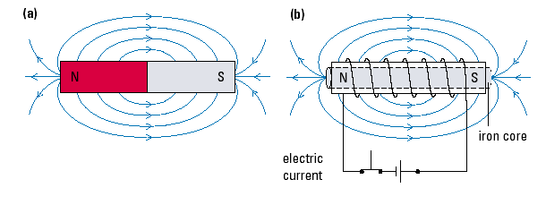
The magnetic field of a solenoid looks like a bar magnet!!
Solenoid

Slide 8
Factors Affecting the
magnetic field of a Solenoid
Current: the more electric current there is the greater concentrated the magnetic field lines are towards the coil (double the current = double the field strength)
Number of Coil Loops: if each loop of wire produces it’s own magnetic field, the more loops that are wound are a core, the stronger the magnetic field (double the number of loops, doubles the magnetic field strength)
Type of Core Material: the material that makes up a coil can greatly affect the coil’s magnetic field strength (iron is better than air)

Slide 9
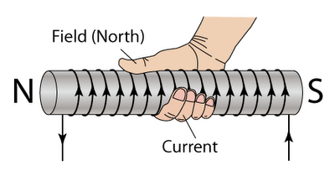
Right Hand Rule #2
•Fingers curl in the direction of current flow through the conductor
• Thumb points in the direction of the induced magnetic north (N)

Slide 10
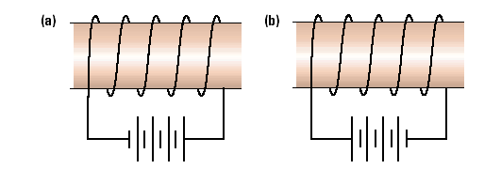
Let’s Try…
Indicate on each diagram the direction of the electric current, the magnetic field lines around the coil, and the north and south poles of the coil.

Slide 11
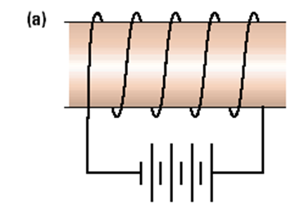
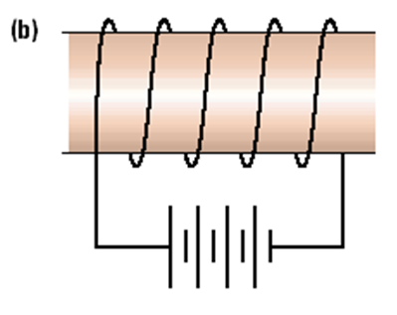
Let’s try...
Indicate on each diagram the direction of the electric current, the magnetic field lines around the coil, and the north and south poles of the coil.
S
N
N
S

Slide 12
Induction
Lenz’s Law

Slide 13
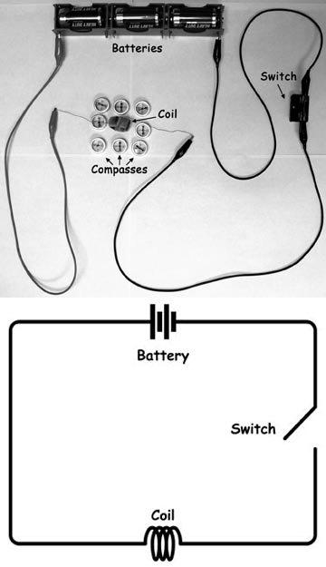
Electricity and Magnetism
Electric Current (Electricity) is moving charge.
Oersted’s Discovery
An electric current will produce a magnetic field!!

Slide 14
Electricity and Magnetism
Electric Current (Electricity) is moving charge.
Oersted’s Discovery
An electric current will produce a magnetic field!!
But Is The Opposite True?

Slide 15
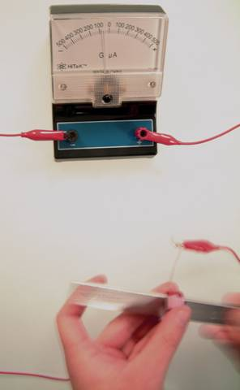
Electricity and Magnetism
A dynamic electric field creates a magnetic field.
A dynamic magnetic field creates an electric field.
The basic principle behind electric generators is creating relative motion between a magnet and a wire to create an electric field that will push current through a circuit.
Converts kinetic energy into electric energy.

Slide 16
Electromagnetic Induction - Laws
Faraday’s Law (1831)
  A changing magnetic field in the region of a closed-loop conductor will induce an electric current.
Lenz’s Law (1834)
  The induced current is in a direction that opposes the change.

Slide 17
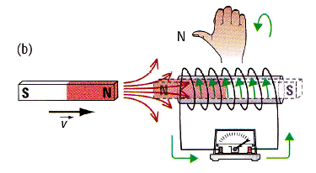
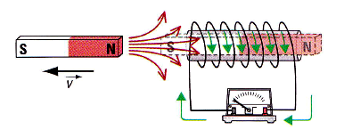
Induction in Solenoids
Induction in Solenoids
Magnet moving toward solenoid
  A magnetic field is induced
  to repel the magnet
  The induced current opposes
  the change
Magnet moving away from solenoid
  A magnetic field is induced
  to attract the magnet
  The induced current opposes
  the change

Slide 18
Electromagnetic Induction – Key Points
Key Points:
  The magnetic field must be changing
  Either the magnet or the solenoid can be moving
  If nothing is changing (or moving) there is no induced current
  The induced current tries to create a new magnetic field that is opposite to the change.

Slide 19


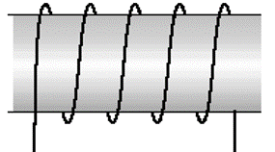


Slide 20
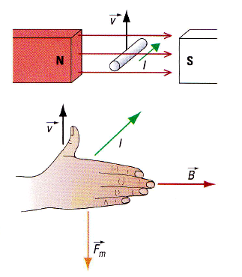
Right Hand Rule #4
Induction in straight wires
  Thumb points in direction of motion
  Fingers point in direction of magnetic field
  Palm points in direction of induced current
  Base of hang points in direction of force (opposite motion)
Factors affecting Force and Current
  The speed of the motion
  The angle of the motion
  Strength of magnetic field
  Length of the wire (in the field)

